Slide 1


Git (Intro)
itechart.com

Slide 2
Why do we need VCS?
• Rollback of incorrect changes
• Clarifying the reasons for the change
• Support for multiple product versions
• Data recovery in case of equipment damage
• Teamwork
• Ability to see changes for a specific task
• Code review

Slide 3
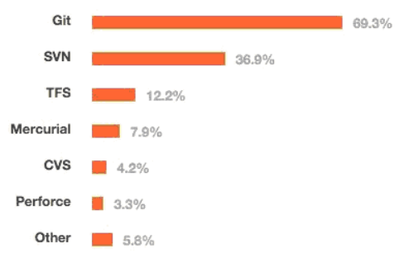
Types
• Local (RCS)
• Centralized (CVS, SVN, Perforce)
• Distributed (Git, Mercurial, Bazaar, Darcs)

Slide 4
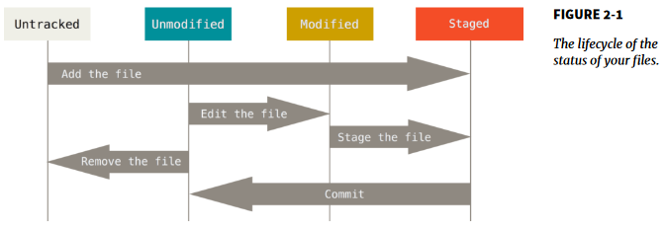
Simple Git Flow
• git init
• git add
• git commit
• git status
• git log
• git <command> --help

Slide 5
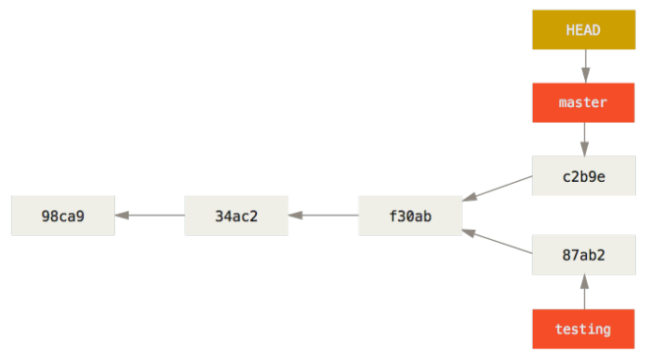
Branches
• git branch <name>
• git checkout <branch>
• git merge <branch>
• git rebase <branch>

Slide 6
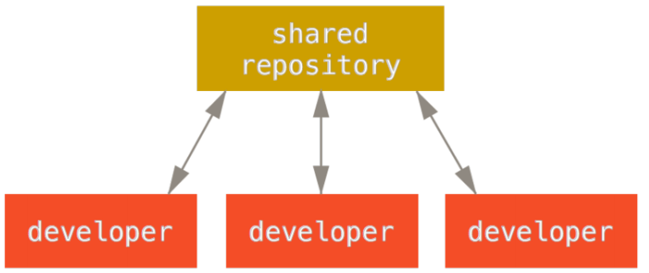
Remote Repository
• git clone
• git fetch
• git push
• git pull (fetch + merge)
• git remote add origin <url>

Slide 7
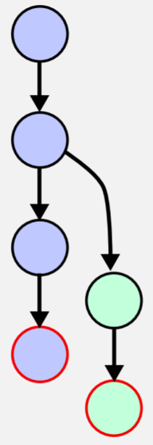
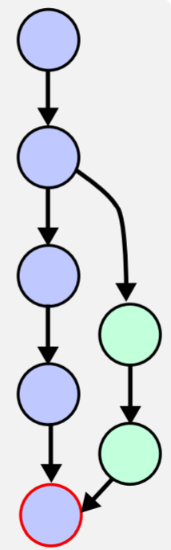
Merge

Slide 8
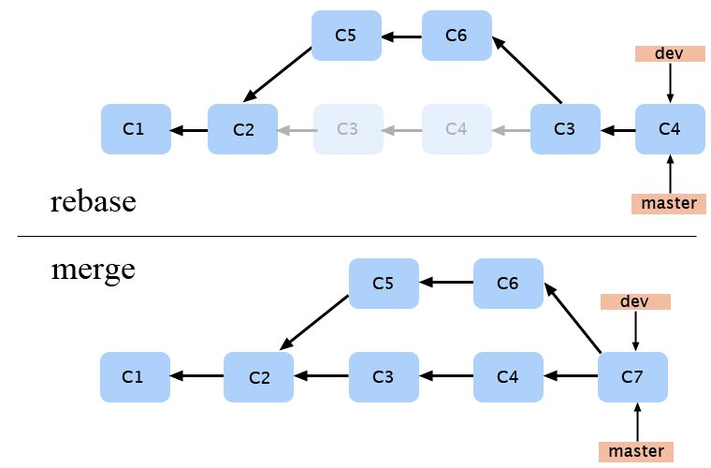
Rebase
• git rebase
• git rebase –onto <base>
• git push -- force

Slide 9
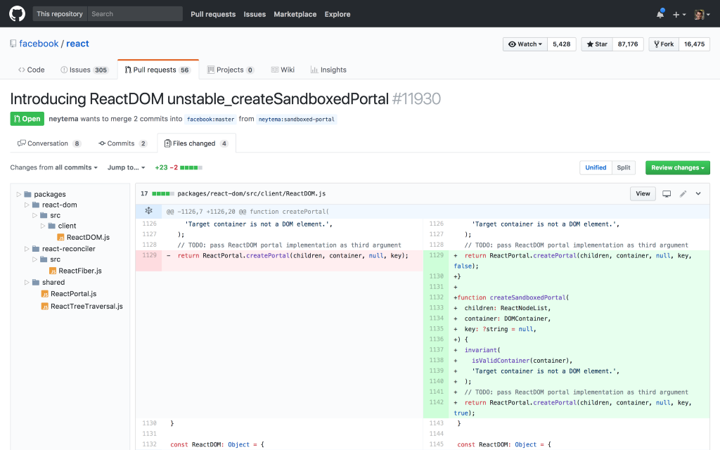
Pull Request
• Notify team
• Discuss and propose
• Collect issues

Slide 10
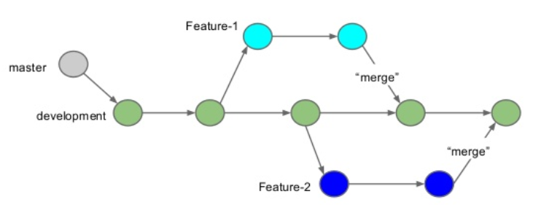
Feature Branch Workflow
All feature development should take place in a dedicated branch.
• Encapsulates features
• Master only contains tested code
• PRs

Slide 11
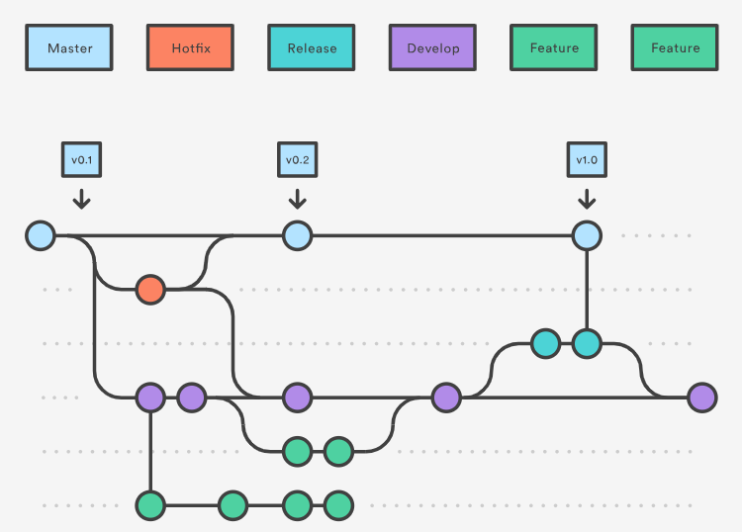
Hotfix Branches

